Slide 1
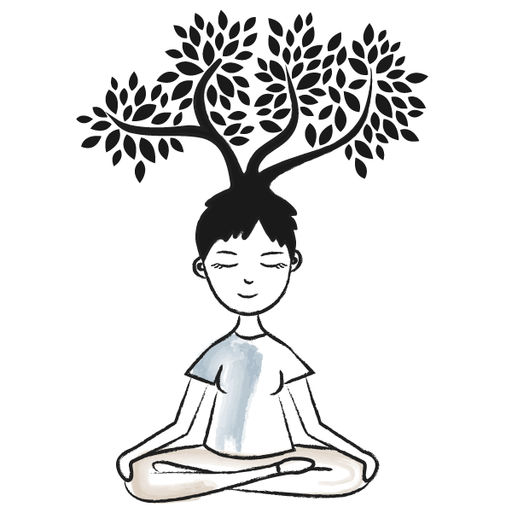
Mindfulness & Metacognition to Increase Engagement
SLAWNY Fall Sharing Event
Saturday, October 19, 2019
Ms. Kirsten Burke Smith, M.S.Ed.
kirstenbsmith829@gmail.com
716.260.0997
@kirstenbsmith
EDTechInspired.com

Slide 2
Kirsten Burke Smith
Single mom of 2 boys
Dance degree and background
Masters degrees in Childhood Education & Literacy
NYS Certs in Early Childhood, Childhood, Literacy (Birth-12), and Dance
Certificate in Meditation – NU
TOSA/Literacy Specialist, LCSD
Current President of the Niagara Frontier Reading Council
Current VP of New York State Reading Association
2019 NYSRA Literacy Educator of the Year recipient
Involved with Breathe for Change
Blog and present frequently
PBS Digital Innovator and Apple Teacher

Slide 3
About this session:
Becoming more aware of thinking, tune into the environment, increase the level of engagement.
Learn how to turn our focus inward, receive information conscientiously, read with comprehension, or find words within ourselves to express our thoughts in writing
Engage Ss through mindfulness practices, using imagery, breath, self-awareness, and self-affirmation.

Slide 4
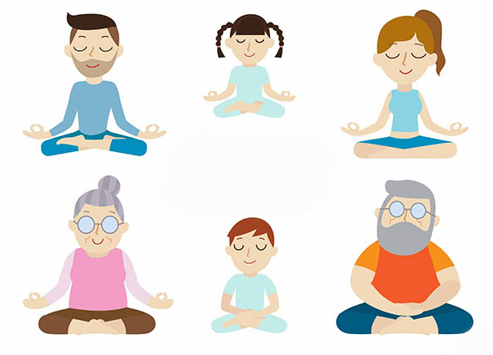
“Inspo”
From my own practices in TI district – high-needs population.
Seek to engage using best practices and strong instruction, which I feel include movement and mindfulness.

Slide 5
Our Main Foci Today:
Mindfulness - a matter of being fully present in the moment.
Exercises and practices
using imagery
breath
Metacognition – awareness and understanding of one's own thought processes.
self-affirmation/self-awareness
(Dweck – Growth Mindset)

Slide 6
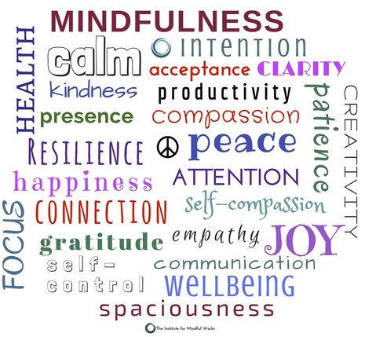
Goal
Come away with at least one new idea
you would like to incorporate
into your library media center, classroom and/or life! ☺

Slide 7
Objectives
Learn about mindfulness, meditation, metacognition, and their roles in any classroom setting.
Empirical evidence, practical examples, lesson plans and age-appropriate mentor texts will be shared.
Perform a guided meditation.
Provide strategies to increase student focus/engagement.

Slide 8
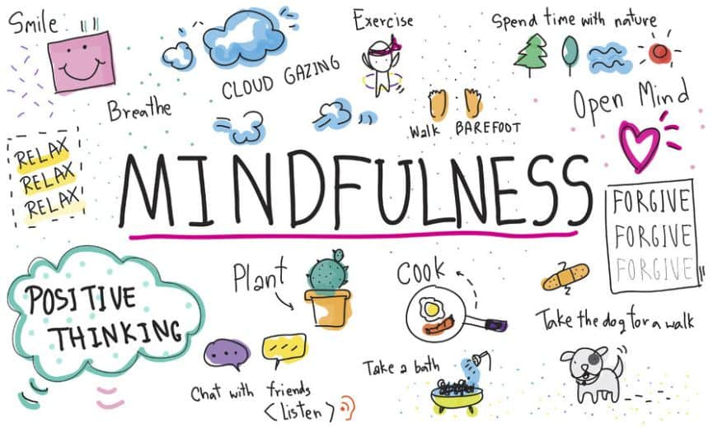
The Pie
Self-Care is so Important!!!!!!!
For EVERYONE.
Berkley article – “Why Self-Compassion Supercedes Self-Esteem” (= Metacognition!)

Slide 9
The importance of self-care

Slide 10
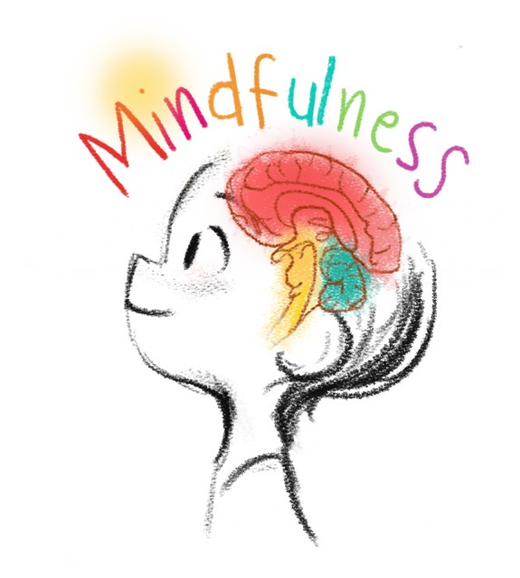
Why mindfulness/Metacognition?
Holistic style of teaching the whole student.
Among 11 factors most important for classroom learning, social and emotional factors accounted for 8.
Decades of research on empirically based social and emotional learning programs have consistently shown well-designed/well-implemented prevention programs offer a means of reducing problem incidence while building skills for mental health, improving classroom behavior, and enhancing achievement. (Wang, Haertel, and Walberg)

Slide 11
We live in A Torrent of Stimulation
According to a report from the University of California, San Diego, in 28 yrs — from 1980 to 2008 — our consumption of info. increased 350%, while our downtime continues to shrink.
In the midst of this multimedia blitzkrieg, the importance of mindfulness and focused attention is rising.
Average American consumes 34 GB of content and 100,000 words every single day, according to the 2008 report from UC San Diego. T (1GB = a symphony in high-fidelity sound or a broadcast quality movie)

Slide 12
The importance of teaching mindfulness
Recent scientific advances have shown interrelated development of emotion and cognition relies on the emergence, maturation, and interconnection of complex neural circuits in multiple areas of the brain.
Circuits involved in the regulation of emotion are highly interactive with those that are associated with “executive functions” (planning, judgment, and decision making), intimately involved in the development of problem-solving skills during the preschool years.
Emotions support executive functions when they are well regulated, but interfere with attention and decision making when they are poorly controlled.
Recent brain imaging studies reveal that sections of our brains are highly active during down time. This has led scientists to imply that moments of not-doing are critical for connecting and synthesizing new information, ideas and experiences.
When feelings are not well managed, thinking can be impaired.

Slide 13
FRACTURED ATTENTION, FRACTURED MIND

Slide 14
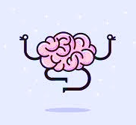
What Do our students need to be successful?
What do children/adolescents need to be successful?
Most typical benchmarks of academic success incl. specific outcomes (i.e. test performance, progress through the educational system, mastery of content knowledge).
School faculty, staff, and therapists who work with youth on a day-to-day basis, witness their progress and their struggles, and know that there is more to this story.
There is little doubt that in addition to academic success, we also want our youth to be happy and well.

Slide 15
What do our students need to be successful?
Channel attention to productive tasks, sustain motivation when work becomes demanding, and handle frustrations of sharing, learning, and communicating with peers (skills that depend on understanding and manage emotions.)
Children and adolescents need to learn these skills alongside more traditionally academic ones.
Demands for these interpersonal, intrapersonal, and problem-solving skills increase as students progress through the school years.

Slide 16
ACEs
Adverse Childhood Experiences
Research and Task Forces
Adverse childhood experiences (ACEs) are traumatic events occurring before age 18. ACEs include all types of abuse and neglect as well as parental mental illness, substance use, divorce, incarceration, and domestic violence.

Slide 17
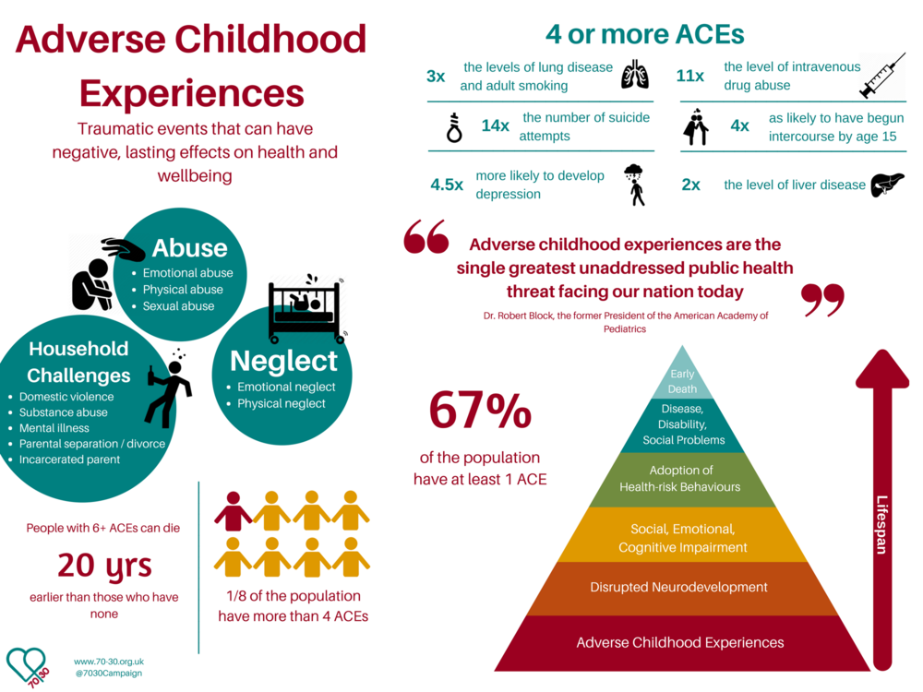

Slide 18
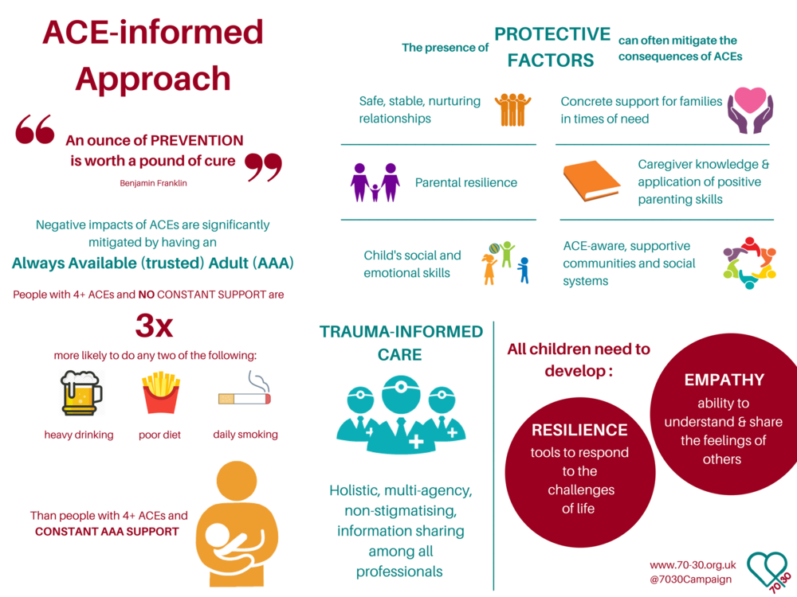

Slide 19
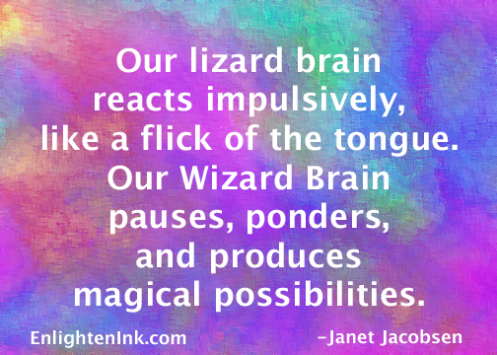
Lizard Brain - Wizard Brain
Lizard – negative/emotional
Wizard – thinking, metacognitive
The Brain’s Negativity Bias – Key for survival
Kids who don’t feel safe have a harder time regulating their moods and emotions.
Research demonstrates that this does not improve as a child matures.
Teflon (Wizard) & Velcro (Lizard) – positive thoughts are Teflon, negative thoughts are Velcro
Train your mind to come up with positive thoughts to replace negative ones (= Metacognition!)

Slide 20
Lizard Brain - Wizard Brain
Social media and access to more readily available info can increase negative thoughts
People who intentionally feel positive do a lot better
Stop and think skills must be learned to assess and analyze a problem, otherwise the emotional, impulsive, non-thinking parts of the brain will respond (“fight or flight”)
Positive thought box in classroom (at the “take a break” spot) for kids to change mindset
https://www.youtube.com/watch?v=YMM67Le2VHA
https://www.buncombeschools.org/departments/student_services/compassionate_schools
Play: https://www.youtube.com/watch?time_continue=173&v=rh4QC_Yhx5A

Slide 21
Right Now…

Slide 22
Strategies and Interventions

Slide 23
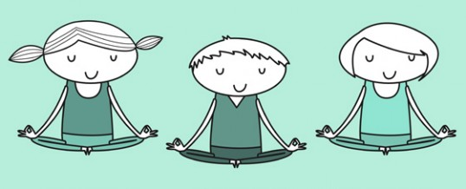
Dr. Michael Rich, a professor at Harvard Medical School put it this way in a 2010 New York Times article:
“Downtime is to the brain what sleep is to the body.”

Slide 24
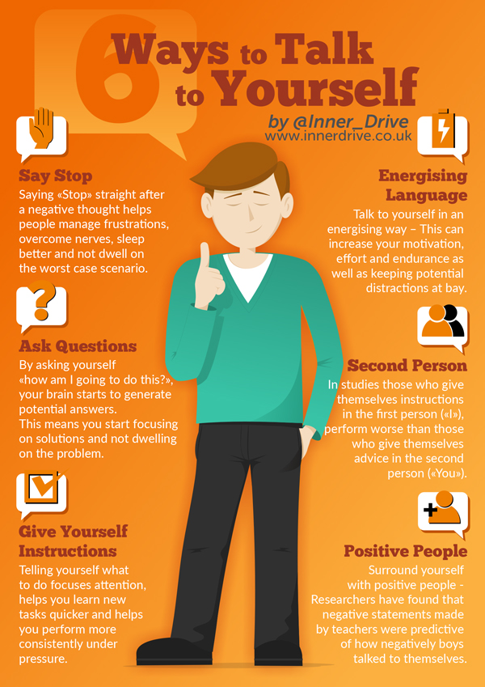
From:
http://blog.innerdrive.co.uk/6-ways-to-improve-how-you-talk-to-yourself

Slide 25
Second Step Curricula

Slide 26
MiNdUp Curricula
From the Hawn Foundation
15 lessons each adapted for grades K-2, 3-5, or 6 and up.
Another: The Calm Classroom curriculum and school‐wide program was originally developed based on two Harvard Medical School studies conducted by Dr. Herbert Benson.

Slide 27
Activity to Engage Awareness:
Objective: observe something in nature closely/mindfully, and share it with the group through art or poetry.
Provide each student with something to record or write their findings.
Invite them to take a mindful walk around the area and notice the natural world.
When they come to something of interest, perhaps something that they have never noticed before, instruct them to stop and observe mindfully (notice shape, color, texture, movement, context, size, and so on).
Encourage them to observe with appreciation and interest.
Ask them to use the paper and pencil to draw a “map” of the walk and a sketch of the objects of mindful observation. The entire activity might take ten to fifteen minutes or longer if desired. No particular expertise in art is required. Ring a bell to return to the group setting.
Great for “small moment” narrative writing, beginning an inquiry based learning project, science lesson, etc.

Slide 28
Activity to Engage Awareness:
After the walkabout, observers might share their experiences with the whole group. This could include describing the map of the particular path.
You may also invite group members to complete a couplet (two-lined poem) based on their experience of mindful observation. Choose one opening line for the whole group, or assign different ones to each member. Some possible opening lines (or sentence starter) include:
Happy for the chance to stop and look,
Still for a while,
I pause and look,
Holding in my steady gaze,
What have I seen on my journey?
What is more beautiful than this?
Walking the path,
I see what’s hidden

Slide 29
Online Resources
Palming/Calming Technique
Cosmic Kids Yoga
Emotional Freedom Techniques (EFT)
EFT Tapping #1 – How to
EFT Tapping #2 – Follow Along with Character (No words – great for ELL’s)

Slide 30
Melting
Empower Tools
Maximo

Slide 31
Dr. Richard Dinenberg’s 5-Minute Meditation A shorter, 3-Minute Meditation

Slide 32
Podcasts

Slide 33
Physical Interventions and Strategies
That don’t use or need technology

Slide 34
Energizing Brain Breaks: Brain breaks are refreshing to students and teachers alike. They do take some time out of class, but the efficiency of our students goes up when we incorporate them.
Body Scan – simple and easy
TelevisionTunes: Name that Theme Song Game. This is a great way to engergize students and introduce them to many different tv theme shows from the past and present.
Cooperative/Kagan & Brain Breaks (You can find more brain breaks at Kagan Publishing)
Elementary and Secondary Brain Break Resources

Slide 35
Belly Breathing: Free resource from PBS
Four Corners: I have my room labeled with North, South, East, West signs at all times. I select a song and have the students walk, dance, whatever they please, around the room. When I stop the music, the kids must report to a “corner of the Earth”. Next, I use my Kagan Selector Tools to select North, South, East, West (or use popsicle sticks). Whoever is in that corner is out! Very simple adaptation to four corners which can be altered to accommodate your content.
Have the students stand up and play R.E.M. - Stand. When a certain direction is said have the student turn in that direction. This is also great for a lesson on "Cardinal Directions.”

Slide 37
Something Calmer for Any age group:
Handful of Quiet
Student explaining it
Oprah interviewing the author for Super Soul Sunday
Important excerpt

Slide 38
Chocolate Meditation from Psychology Today

Slide 39
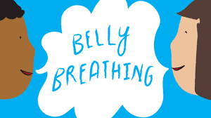
10 Steps to Mindfulness Meditation
Create a Time and Space
Set a Timer
Sit in a Comfortable Position
Check Your Posture
Take Deep Breaths
Direct Your Attention to Your Breath
Maintain Attention to Your Breath
Repeat Steps 6-7.
Be Kind to Yourself.
Prepare for a Gentle Ending

Slide 41
Do you employ Any of these or other practices?
Let’s Share out!

Slide 42
Resources:
http://www.sidewaysthoughts.com/blog/2014/01/mindfulness-defined-a-resolution-to-consider/
Gonoodle.com
https://www.psychologytoday.com/blog/mindfulness-in-frantic-world/201109/the-chocolate-meditation
http://teachinginstyle.wordpress.com/2011/12/05/tips-and-tricks-fun-brain-breaks/
https://youtu.be/Hu7ld_EABWU
http://blog.innerdrive.co.uk/6-ways-to-improve-how-you-talk-to-yourself

Slide 43
Research:
Barnes, V. A., Bauza, L. B. & Treiber, F. A. (2003). Impact of stress reduction on negative school behavior in adolescents. Health and Quality of Life Outcomes, 1(10).
Full Research Report…
Benson, H., & Wilcher, M. (2000). Academic performance among middle school students after exposure to a relaxation response curriculum. Journal of Research and Development in Education, 33(3), 156-165.
Full Research Report…
Benson, H., Kornhaber, A., Kornhaber, C., LeChanu, M., Zuttermeister, P., Myers, P., et al. (1994). Increases in positive psychological characteristics with a new relaxation-response curriculum in high school students. Journal of Research & Development in Education, 27, 226–231.
Full Research Report…
Dacey, J. S., DeSalvatore, L. E., & Robinson, J. E. (1996). The results of teaching middle school students two relaxation techniques as part of a conflict prevention program. Research in Middle Level Education Quarterly, 91-102. Full Research Report…
Foret, M. M., Scult, M., Wilcher, M., Chudnofsky, R., Malloy, L., Hasheminejad, N., Park, E. R. (2012) Integrating a relaxation response-based curriculum into a public high school in Massachusetts, Journal of Adolescence 35, 325–332.
Full Research Report…
Norlander, T., Moas, L., & Archer, T. (2005). Noise and stress in primary and secondary school children: Noise reduction and increased concentration ability through a short but regular exercise and relaxation program. School Effectiveness and School Improvement, 16(1), 91-99.
Full Research Report…

Slide 44
Research:
Relaxation Response Research
Esch,, T., Fricchione, G. L., & Stefano, G. B. (2001). The therapeutic use of the relaxation response in stress-related disease. Med Sci Monit, 9(2), RA23-34.
Full Research Report…
Mindfulness Research
Beauchemin, J., Hutchins, T. L., & Patterson, F. (2008). Mindfulness meditation may lessen anxiety, promote social skills, and improve academic performance among adolescents with learning disabilities. Complementary Health Practice Review, 13(1), 34–45.
Full Research Report…
Flook, L., Smalley, S. L., Kitil, M. J., Galla, B. M., Kaiser-Greenland, S., Locke, J., Ishijima, E., & Kasari, C. (2010). Effects of mindful awareness practices on executive functions in elementary school children. Journal of Applied School Psychology, 26(1), 70–95.
Full Research Report…
Kabat-Zinn, J. (2003). Mindfulness-based interventions in context: Past, present, and future. Clinical Psychology:

Slide 45
Research, Continued:
Science and Practice, 10(2), 144–156.
Full Research Report…
Kuyken, W., Weare, K., Ukoumunne, O., Vicary, R., Motton, N., Burnett, R., Cullen, C., Sarah Hennelly, S., Huppert, F. (2013). Effectiveness of the Mindfulness in Schools Programme: non-randomized controlled feasibility study. The British Journal of Psychiatry 1–6. doi: 10.1192/bjp.bp.113.126649.
Full Research Report…
Haydicky, J. A. (2010). Mindfulness training for adolescents with learning disabilities. (Unpublished Master’s thesis). University of Toronto.
Full Research Report…
Lee, J., Semple, R.J., Rosa, D., & Miller, L. (2008). Mindfulness-based cognitive therapy for children: Results of a pilot study. Journal of Cognitive Psychotherapy, 22(1), 15-28.
Full Research Report…
Mendelson, T., Greenberg, M. T., Dariotis, J. K., Feagans Gould, L., Rhoades, B. L., & Leaf, P. J. (2010). Feasibility and preliminary outcomes of a school-based mindfulness intervention for urban youth. Journal of Abnormal Child Psychology, 38, 985–994.
Full Research Report…

Slide 46
Research, Continued:
Napoli, M., Krech, P. R., & Holley, L. C. (2005). Mindfulness training for elementary school students: The Attention Academy. Journal of Applied School Psychology, 21(1), 99–125.
Full Research Report…
Semple, R. J., Reid, E. F. G., & Miller, L. (2005).Treating anxiety with mindfulness: an open trial of mindfulness training for anxious children. Journal of Cognitive Psychotherapy, 19(4), 379–392.
Full Research Report…
Singh, N. N., Lancioni, G. E., Singh Joy, S. D., Winton, A. S. W., Sabaawi, M., Wahler, R. G., & Singh, J. (2007). Adolescents with conduct disorder can be mindful of their aggressive behavior. Journal of Emotional and Behavioral Disorders, 15(1), 56–63.
Full Research Report…
Zylowska, Ackerman, Yang, Futrell, Horton, Hale, Smalley (2007). Mindfulness Meditation Training in Adults and Adolescents with ADHD A Feasibility Study. Journal of Attention Disorders, Volume XX Sage Publications 10.1177/1087054707308502
Full Research Report…

